Slide 1

Agricultural Data Analytics Dashboarding using Snowflake & Power BI
Presented By: Shraddha Mali
Tools Used: AWS S3, Snowflake, SQL, Power BI

Slide 2
Executive Summary
Built an end-to-end analytics pipeline for agricultural data.
Automated data ingestion from AWS S3 → Snowflake → Power BI.
Created dashboards for rainfall, temperature, humidity, and crop yield analysis.
Delivered actionable insights for year, location, crop, and seasonal trends.

Slide 3
Problem Statement / Objective
Agricultural productivity is highly dependent on climate factors.
Lack of visibility into how rainfall, temperature, and humidity affect yield.
Objective:
Build dashboards to analyze yearly, seasonal, and regional agricultural trends.
Provide insights to support better farming and policy decisions.

Slide 4
Dataset Description
Source: data_season dataset uploaded to AWS S3.
Dataset Size: 3,158 rows × 12 columns
Key Fields:
Year – year of data record
Irrigation – irrigation method used
Location – city/region of cultivation
Yeilds – crop yield (quantity produced)
Area – cultivated land area
Humidity – average humidity (%)
Rainfall – annual rainfall (mm)
Crops – crop cultivated
Temperature – average temperature (°C)
Price – market price of crop
Soil type – type of soil in the region
Season – agricultural season (e.g., Kharif, Rabi, etc.)
Data Type: Combination of time-series, categorical, and numerical data.
Focus Variables for Analysis: Rainfall, Temperature, Humidity, Yield, Crop, and Season.

Slide 5




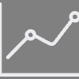







Data Pipeline Workflow
Ingest
Validate
Transform
Analyse
Visualise
Uploaded dataset to Amazon S3 bucket.
Configured IAM role & trust policy for Snowflake integration.
Loaded dataset into Snowflake SQL worksheet.
Performed data transformations in Snowflake.
Connected transformed data to Power BI .
Build PowerBI dashboards & Published to Service.

Slide 6



Data Transformations
Created year categories (Y1, Y2, Y3) based on year levels.
Added Rainfall Groups: Low, Medium, High.
Cleaned missing values and standardized data fields.

Slide 7
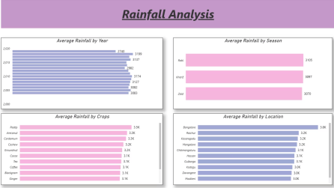
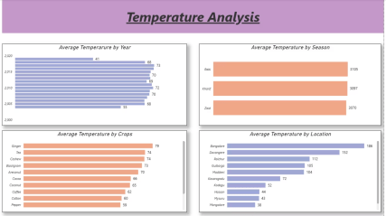
Dashboards
Seasonal & regional variations in crop conditions.
Trends across years, crops, and locations.
Grouped into low, medium, high rainfall levels.

Slide 8
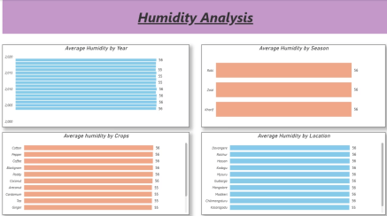
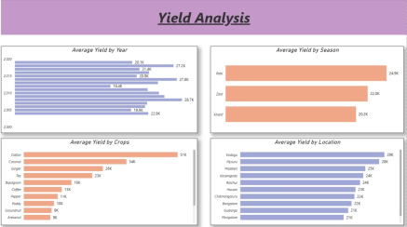
Dashboards
Gives Insight on Effect of humidity on yield patterns.
Yield comparison by year, location, season, and crop type.

Slide 9


Results
Successfully integrated AWS S3 → Snowflake → Power BI.
Built interactive dashboards for rainfall, temperature, humidity, and yield.
Discovered relationships between climate factors and agricultural output.
Key Insights:
1
2
3
Certain crops yield better in specific rainfall groups.
Seasonal variations strongly influence temperature & humidity trends.
Yield patterns are directly correlated with climate conditions.

Slide 10



Impact & Business Value
Helps farmers and policymakers optimize crop planning.
Provides climate-based insights for agricultural strategies.
Scalable pipeline for future real-time agricultural datasets.
Learnings
1
Practical experience with AWS–Snowflake–Power BI integration.
2
Building data transformation logic for agricultural datasets.
3
Designing domain-specific dashboards for agriculture.

Slide 11


Conclusion:
Proved that integrating cloud platforms with BI tools provides actionable insights for farming decisions.
Built a cloud-to-dashboard analytics solution for agriculture.
1
2

